Slide 1
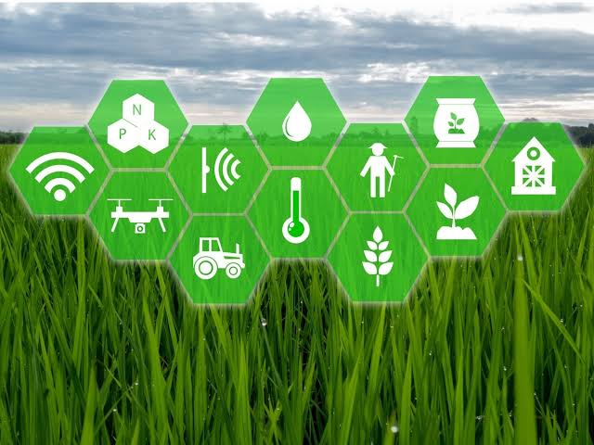

MoistaSoil
Digital Agri based Company

Slide 2

About MoistaSoil
Company based in India, with an aim of bringing Sustainability in Agriculture and opening new ways for farmers. We are a Company with an aim and Big ambitions.
MoistaSoil has a vision of providing help and services to the farmers who have to work continuously in farms even in the harsh weather. Our idea provides a simple solution to them at a marginal cost. Also our focus is on engaging with contract companies so that farmers can focus on more efficient ways of farming thus saving time as well as energy.

Slide 3
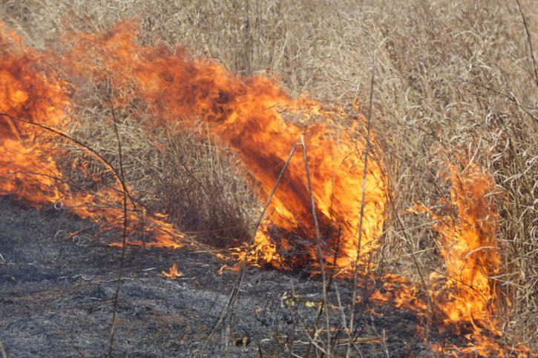
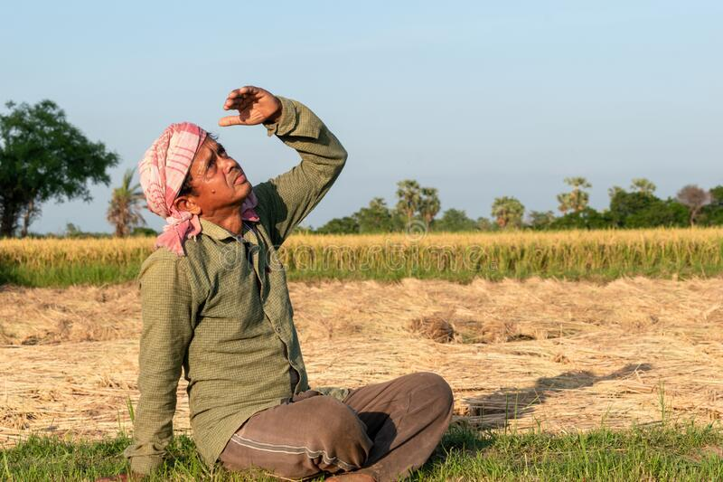
Problems Solved by MoistaSoil
Many farmers consider agricultural burning the most effective and cost-efficient way to clear land, fertilize soil and prepare it for new plantation. However, these blazes and the wildfires that spread from them are the world’s largest source of black carbon, a threat both to human and environmental health. MoistaSol will be now eradicating this by taking the crop residue from the farmers and converting it into manure.
Many farmers are being affected by the heat strokes which have been increasing since day one. The upcoming october heat is expected to cause more damages. MoistaSol will help through the remote sensors which will irrigate the fields on its own, thus preventing our farmers getting affected by heat waves as well as strokes.

Slide 4
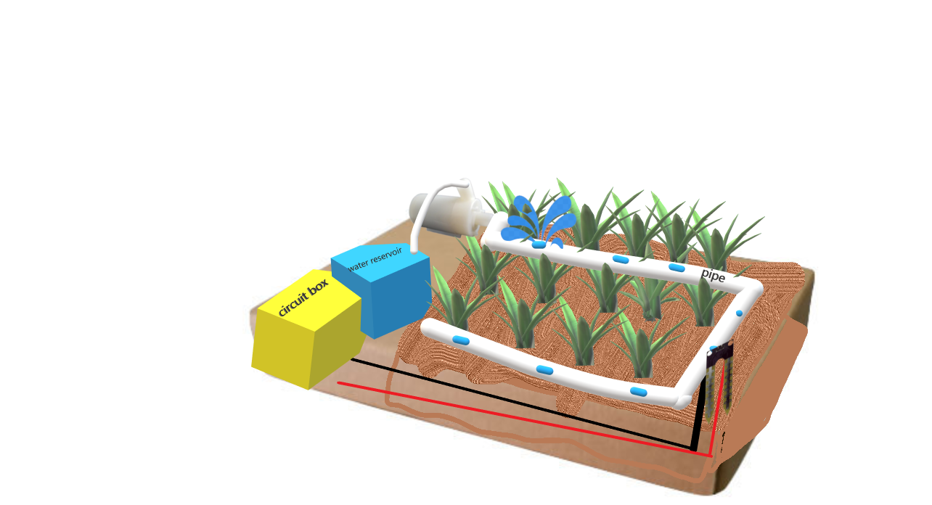
Services Provided
1. Fully automatic Irrigation Facilities
A MOTOR
User experience
Physical Computing
HTML, CSS,JS
5 SENSORS
PIPELINES

Slide 5
2. App Bases Services
Full track of usage of the irrigational equipments installed
Sale of manure and outsourcing of fertilisers etc.
Educational courses for improving farming methods
Physical Computing
HTML, CSS,JS
User experience

Slide 6
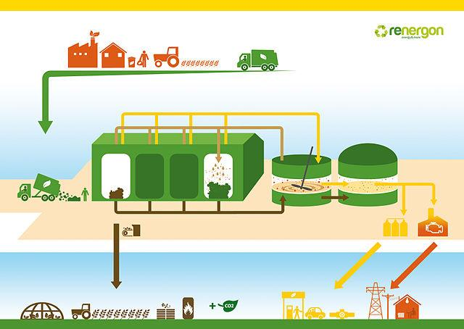
3. Manure Manufacturing from crop waste
MoistaSoil will take crop waste from farmers, this will help the environment as well because these crop wastes are burnt by the farmers which is responsible for the growing air pollution and the increasing AQI. We will make manure from the crop waste and then further sell it.
er experience
Physical Computing
HTML, CSS,JS

Slide 7
Features of MoistaSoil

Slide 8




Technology Inputs
Our app will be connected with the motors and sensors. It will be available on iOS as well as Android.
A simple user interface
Fully secured application
24/7 customer support service
Tech based Eductaional courses

Slide 9
SUCCESS FACTORS
Providing Solutions
Our product is providing a solution for a mass population depending on agriculture.
Benefitting Farmers
This is an incentive for 10 lakh farmers of punjab to utilise their time for another productive activity.
Helping the Ecosystem
Much of the crop waste is utilised for making manure, which results in helping ecosystem because this waste would not be burnt and hence will help in reducing the threat of air pollution to the Nation

Slide 10
Promotional
Strategy
Advertisements in local agriculture markets
Push for Involvement in Government schemes
Various social media influencers
Word of mouth

Slide 11
Earning
Strategy
50% of the manure produce will be sold
App Subscription
Service Charges
By selling Fertilisers(White- Labeling)
Through irrigation systems
Commissions from outsourcing

Slide 12
Requirements
App development
Government-Regular water and electricity supply along with collaboration with manure manufacturing plants.
Transportation-Tie ups with drivers for smooth delivery and pickup of manure/crop waste.
Fertilisers companies - Outsourcing
Farmers/ End users- Expected to provide contact details and time to time feedback
Mentors/Teachers- Planning Course Content

Slide 13
Costing of Irrigation System per acre land-
1
2 HP motor
Average motor required for supplying water would cost around 7k -8k
2
sensors
Our team would install 5 sensors in 1 acre land and it would cost around 2k
3
Pipelines
Establishing the pipelines over field would cost about 2k

Slide 14
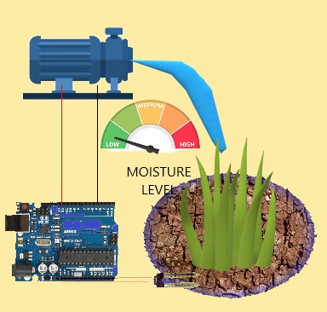
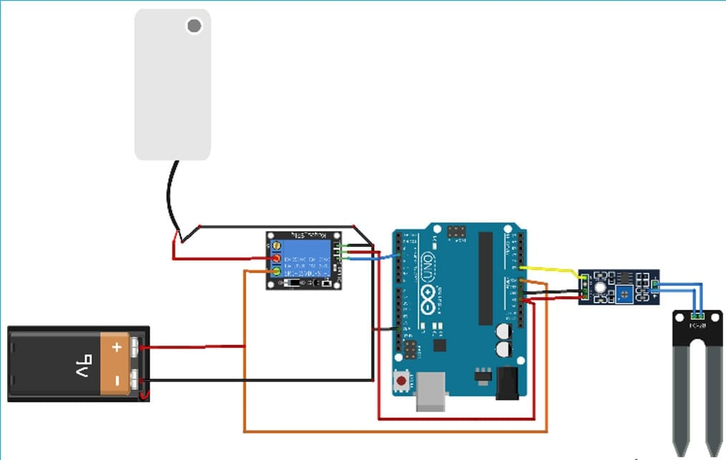
Field Diagram
Circuit Diagram

Slide 15
FINANCIAL ASPECTS – PROJECT COSTING ( 1ST year)
S.NO. | Particulars |  | Cost [Rupees in lakhs]
1. | Rental land (300 sq.yard for office cum assemblation center. 500 sq.yard for storage house) |  | 5
2. | Employment cost |  | 32
3. | Marketing cost |  | 3
4. | miscellaneous |  | 5
5. | System costing |  | -(separate section)
Total |  |  | Rs. 45 lakhs

Slide 16
Divisions of key elements -
EMPLOYEES COSTING –
3 employees – 3* (6000) * 12 = Rs. 2,16,000
2 technicians – 2*(30,000)*12 = Rs. 7,20,000
4 engineers – 4*(30,000)*12 = Rs. 14,40,000
3 labour employees – 3*(22,000)*12 = Rs. 7,92,000
total = Rs. 31,68,000
approx. Rs. 32 lakhs
Marketing expenses
Awareness campaigns
Newspaper
Local media
Word of mouth
total = Rs. 3 lakhs

Slide 17
Profit projections ( irrigational land of Punjab – 9941049 acres)
 | I Year | II Year | III Year
SALE UNITS | 25,000 | 30,000 | 50,000
PROFIT(inRs.) | 4000 p.u. | 3800 p.u. | 3600 p.u.
TOTAL PROFIT (crore) | 1 | 1.14 | 1.80

Slide 18
App projections –
App development and maintenance price – Rs. 40 lakhs
Transportation expenses for year – Rs 5 lakhs
TOTAL APP INVESTMENT – Rs. 45 lakhs
App subscription price – Rs. 979
estimated app subscriptions – ( 1st year ) = 1500 ; revenue = Rs. 14,68,500
(2nd year) = 20,000 + 2000 ; revenue = Rs. 2,15,38,000

Slide 19
Overall
Total investment initially = Rs . 90,00,000 + Rs. 10,00,000 (for initial 100 irrigation systems)
= Rs. 1 cr
PROMOTER’S CONTRIBUTION = 10 %

Slide 20
THANKYOU

